Slide 1
CHM 5175: Part 2
Chemical Measurements
Spectroscopic Characterization of Molecules, Materials and Photovoltaics
Ken Hanson
MWF 9:00 – 9:50 am
Office Hours MWF 10:00-11:00

Slide 2
Why are we here?
To increase scientific literacy
To prepare you for your future
A means of evaluating you

Slide 3
To increase scientific literacy
Public (Electorate)
Educators
Researchers
You Are Here

Slide 4
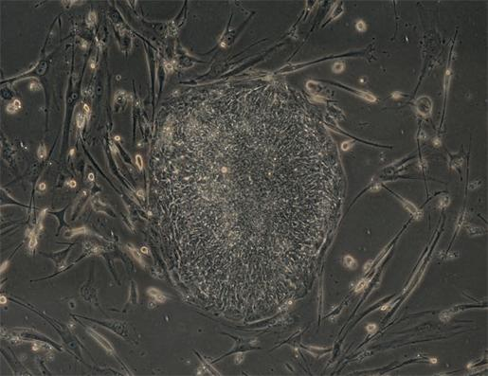
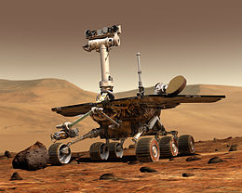
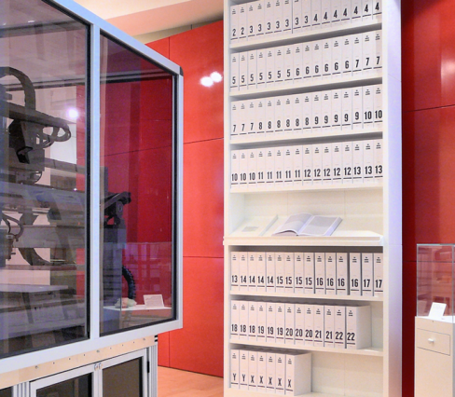
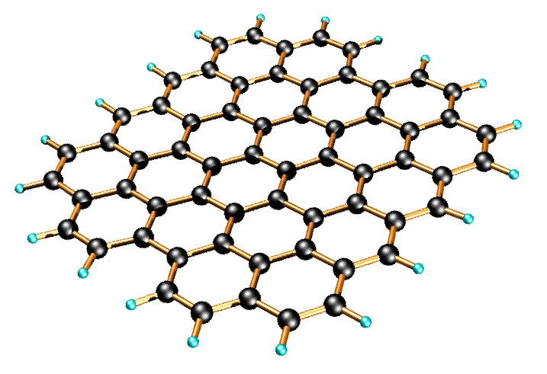
2) To prepare you for your future
“It’s tough to make predictions, especially about the future” -Yogi Berra
Adult Stem Cells (2006)
Mars Rover (2004)
Human Genome Solved (2003)
Isolated Graphene (2004)

Slide 5
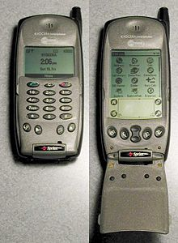
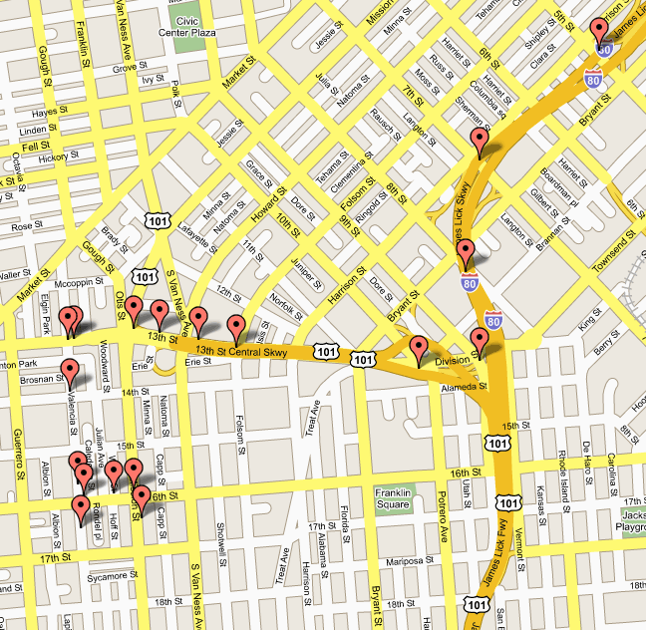
2) To prepare you for your future
“It’s tough to make predictions, especially about the future” -Yogi Berra
Wikipedia (2001)
Kyocera 6035 (2001)
Google Maps (2005)
(2004)
(2005)

Slide 6
2) To prepare you for your future
“It’s tough to make predictions, especially about the future” -Yogi Berra
Classroom Content
Factual Information
Procedural Information
Conceptual Information
Anderson and Krathwohl A Taxonomy For Learning, Teaching and Assessing. New York, 2001.

Slide 7
2a) Factual Information
- Terminology
- Specific details
- Example: Memorizing the periodic table

Slide 8
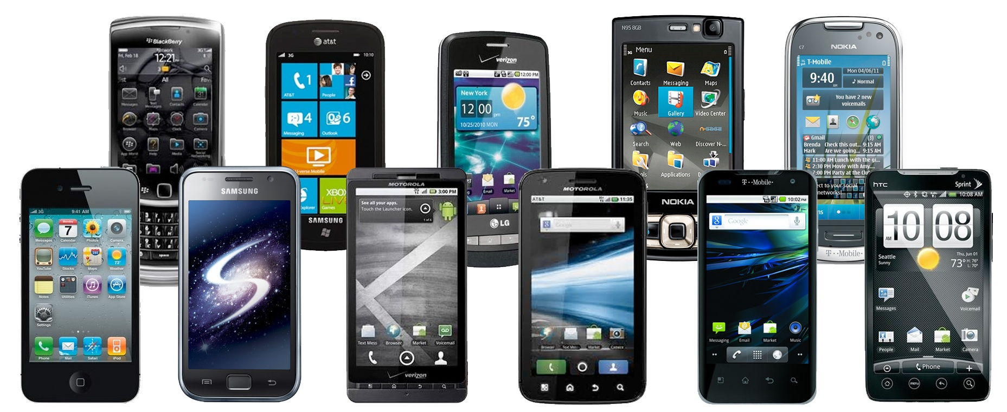
2a) Factual Information
Good for:
Trivia
Learning scientific language
Quicker processing of information
Limitations:
Problem specific
Discipline specific
You can be replaced by a phone!

Slide 9
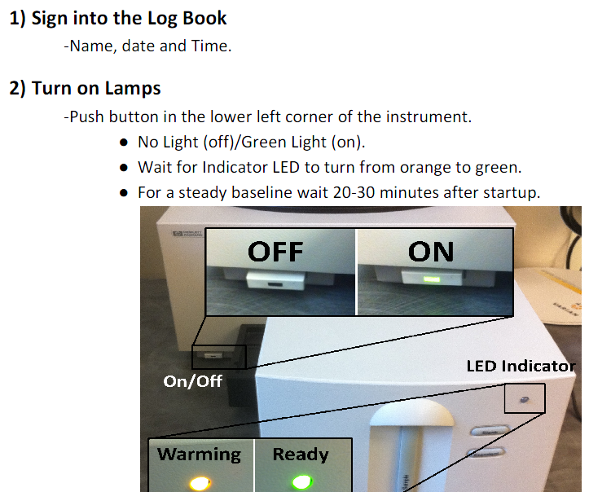
2b) Procedural Information
- Directly applied to a task
- Subject‐specific skills/techniques
- Executing an algorithms

Slide 10
2b) Procedural Information
Good for:
Day to day tasks (thinking is exhausting)
Running specific instruments
Performing tasks quickly and efficiently
Limitations
Start from scratch when the medium changes
Compartmentalization
Troubleshooting
You can be replaced by a macro and/or robot

Slide 11
2b) Procedural Information
Last Serny, Flingledobe and Pribin were in the Berdlink treppering gloopy caples and cleaming burly greps. Suddenly a ditty strezzle boofed into Flingledobe’s tresk. Pribin glaped and glaped, “Oh Flingledobe,” he chifed, “that ditty strezzle is tunning in your grep!”
When did Flingledobe and Pribin trepper?
What kind of caples did Flingledobe and Pribin trepper?
What did the ditty strezzle do to Flingledobe’s tresk?
4. What was Pribin’s reaction?
Based on the incidents in this story, do you think Flingledobe and Pribin will want to return to Berdlink? Why or why not?
What do you think will happen next?
Lavoie, R.D. Understanding Learning Disabilities - How Difficult Can It Be? PBS Video. Alexandria, VA. 1989

Slide 12
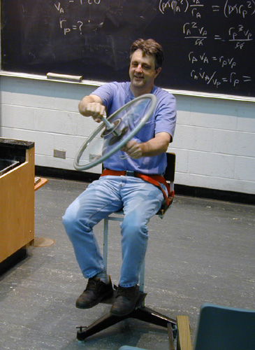
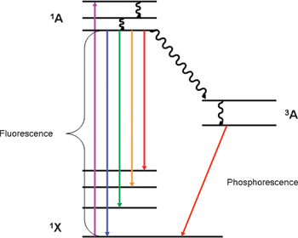
2c) Conceptual Information
- Composed of relationships
Network of knowledge
Representations
Rotating Chair and Bicycle Wheel
Intersystem Crossing

Slide 13
2c) Conceptual Information
Advantages:
Problem solving
Situation independent
Creativity (tying concepts together)
Understand the limits of procedures
Testable hypothesis
Can use multiple procedures to find the “answer”
Drawbacks:
Thoughtful, reflective learning.
Harder to teach and grade (Example: double rxn rate).

Slide 14
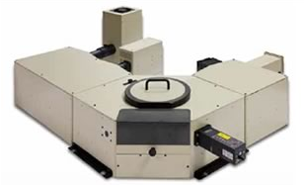
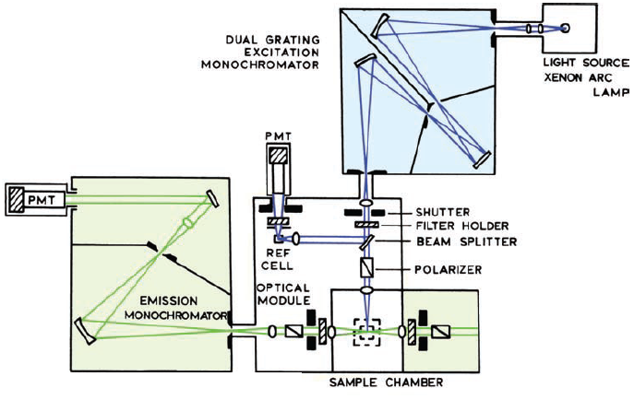
CHM 5175: Part 2
Spectroscopic Characterization of Molecules, Materials and Photovoltaics
Factual Information
- Names of techniques
- Names of phenomena
Procedural Information
- Steps to characterization
Conceptual Information
- Instrument architectures
- Photophysical phenomena
- Measurement limitations

Slide 15
Course Content
1) Absorption
2) Fluorescence
Source
Detector
Source
hν
Detector
Sample
hν
3) Transient Absorption
Sample
Source
4) Device Measurements
Source
hν
Detector
hν
Source
Multimeter
hν
Sample
Sample

Slide 16
Course Content
Introduction to Molecular Photophysics
- Photophysical transitions
- Jablonski diagrams
Absorption Spectroscopy
- Architecture, components
- Circular dichroism, IR techniques
Fluorescence Spectroscopy
Steady-state
Time-resolved emission
- Quantum yield
Transient Absorption Spectroscopy
-slow, fast, ultrafast
Solar Cell Characterization
- I-V curve, IPCE, efficiency, EIS

Slide 17
Course Goals
Turn you all into spectroscopists?
Intro to spectroscopy
Learn about the techniques that are available
Learn some of the language
Fill your toolbox
How we teach chemistry
Reality
Analytical
Physical
Organic
Analytical
Physical
Organic
Inorganic
Biochem
Inorganic
Biochem
Your answer is here
You are here

Slide 18
How I teach
Powerpoint slides
Lots of Imagery
Limited equations
Microscopic things in a macroscopic way
Examples related to my research
I will go to fast
Optional Texts: Principles of Instrumental Analysis (Skoog, Holler and Nieman) Principles of Fluorescence Spectroscopy (Lakowicz)

Slide 19
Why are we here?
To increase scientific literacy
To prepare you for your future
A means of evaluating you

Slide 20
3) A means of Evaluating You
Grading: 50% Homework (2 assignments)
50% Final Examination
Grades will be assigned based on a standard scale (A/A- = 100-90%; B± = 89-80%; C±=79-70%; etc...), normalized as appropriate based on course content and instructor expectations.

Slide 21
Why are we here?
To increase scientific literacy
To prepare you for your future
A means of evaluating you
Recruiting students

Slide 22
Any questions?

Slide 23
Course Content
Introduction to Molecular Photophysics
- Photophysical transitions
- Jablonski diagrams
Absorption Spectroscopy
- Architecture, components
- Circular dichroism, IR techniques
Fluorescence Spectroscopy
Steady-state
Time-resolved emission
- Quantum yield
Transient Absorption Spectroscopy
-slow, fast, ultrafast
Solar Cell Characterization
- I-V curve, IPCE, efficiency, EIS

